Slide 1

UNIT 4 DEADLOCKS

Slide 2
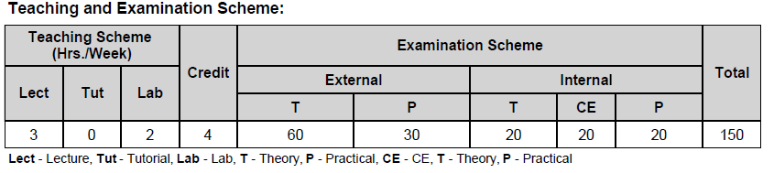
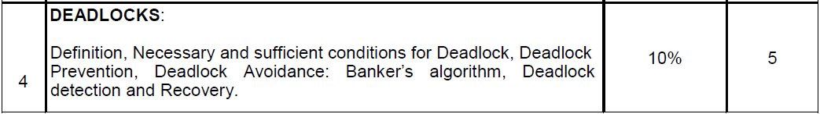
Syllabus

Slide 3
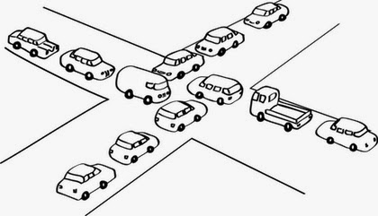
What is Deadlock?

Slide 4
Deadlock
A set of blocked processes each holding a resource and waiting to acquire a resource held by another process in the set is known as a Deadlock.
A process is deadlocked if it is waiting for an event that will never occur.
Process
Process
Hold
P1
Request
R1
DEADLOCK
R2
Request
Hold
P2
Hold
Resource
Resource
Request

Slide 5
Example - Bridge Crossing
Assume traffic in one direction.
Each section of the bridge is viewed as a resource.
If a deadlock occurs, it can be resolved only if one car backs up (preempt resources and rollback).
Several cars may have to be backed up if a deadlock occurs.
Starvation is possible

Slide 6
Types of Resources
Preemptable:- Preemptive resources are those which can be taken away from a process without causing any ill effects to the process.
Example:- Memory.
Non-preemptable:- Non-pre-emptive resources are those which cannot be taken away from the process without causing any ill effects.
Example:- CD-ROM (CD recorder), Printer.

Slide 7
Conditions for Deadlock
Mutual exclusion
Each resource is either currently assigned to exactly one process or is available.
Hold and wait
Process currently holding resources granted earlier can request more resources.
No preemption
Previously granted resources cannot be forcibly taken away from process.
Circular wait
There must be a circular chain of 2 or more processes. Each process is waiting for resource that is held by next member of the chain.
All 4 of these conditions are necessary and sufficient for deadlock (must hold simultaneously)

Slide 8


Resource Allocation Graph
A visual way to determine if a deadlock has, or may occur.
Process is a circle, Resource type is square; dots represent number of instances of resource in type.
An arrow from the process to resource indicates the process is requesting the resource. a An arrow from resource to process shows an instance of the resource has been allocated to the process.

Slide 9
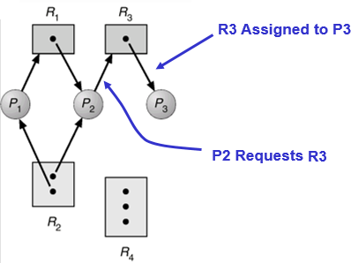
Resource Allocation Graph
If the graph contains no cycles, then no process is deadlocked.
If there is a cycle, then:
If resource types have multiple instances, then deadlock MAY exist.
b) If each resource type has 1 instance, then deadlock has occurred.
Resource Allocation Graph

Slide 10
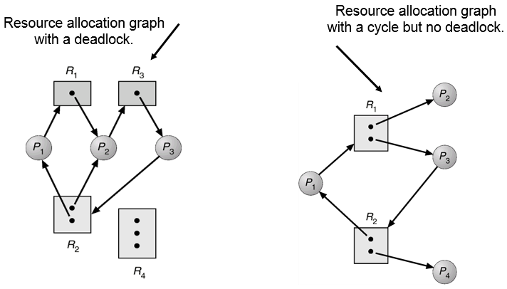
Resource Allocation Graph

Slide 11
Methods for handling deadlocks
Just ignore the problem.
Detection and recovery.
Let deadlocks occur, detect them and take action.
Dynamic avoidance by careful resource allocation.
Prevention, by structurally negating (killing) one of the four required conditions.

Slide 12
Deadlock Management
Prevention
Design the system in such a way that deadlocks can never occur
Avoidance
Impose less stringent (tight) conditions than for prevention, allowing the possibility of deadlock but sidestepping it as it occurs.
Detection
Allow possibility of deadlock, determine if deadlock has occurred and which processes and resources are involved.
Recovery
After detection, clear the problem, allow processes to complete and resources to be reused. May involve destroying and restarting processes.

Slide 13

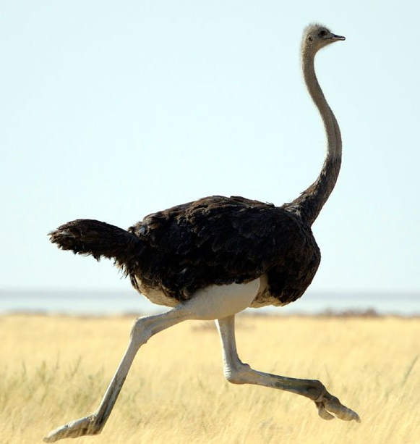
Deadlock ignorance (Ostrich Algorithm)
When storm approaches, an ostrich puts his head in the sand (ground) and pretend (imagine) that there is no problem at all.
Ignore the deadlock and pretend that deadlock never occur.
Reasonable if
deadlocks occur very rarely
difficult to detect
cost of prevention is high
UNIX and Windows takes this approach

Slide 14
Deadlock Prevention
Deadlock prevention algorithms ensure that at least one of the necessary conditions (Mutual exclusion, hold and wait, no preemption and circular wait) does not hold true.
However most prevention algorithms have poor resource utilization, and hence result in reduced throughputs.

Slide 15
Mutual Exclusion:
No deadlock if each resource can be assigned to more than one process.
We can not assign some resources to more than one process at a time such as CD-Recorder, Printer etc…
So this solution is not feasible.

Slide 16
Hold and Wait
A process can get all required resources before it start execution. This will avoid deadlock, but will result in reduced throughputs as resources are held by processes even when they are not needed. They could have been used by other processes during this time.
Second approach is to request for a resource only when it is not holding any other resource. This may result in a starvation as all required resources might not be available freely always.

Slide 17
No preemption
If a process that is holding some resources requests another resource that cannot be immediately allocated to it, the process releases the resources currently being held.
Pre-empted resources are added to the list of resources for which the process is waiting.
Process will be restarted only when it can regain its old resources as well as the new ones that it is requesting.

Slide 18
Circular Wait
To avoid circular wait, resources may be ordered and we can ensure that each process can request resources only in an increasing order of these numbers. The algorithm may itself increase complexity and may also lead to poor resource utilization.

Slide 19
Deadlock Avoidance
If we have prior knowledge of how resources will be requested, it's possible to determine if we are entering an "unsafe" state.
Simplest and most useful model requires that each process declare the maximum number of resources of each type that it may need.
The deadlock-avoidance algorithm dynamically examines the resource-allocation state to ensure that there can never be a circular-wait condition.
Resource allocation state is defined by the number of available and allocated resources, and the maximum demands of the processes.

Slide 20
Safe State:
When a process requests an available resource, system must decide if immediate allocation leaves the system in a safe state.
System is in safe state if there exists a safe sequence of all processes.
Sequence <P1, P2, …Pn> is safe, if for each Pi, the resources that Pi can still request can be satisfied by currently available resources + resources held by Pj with j<i.

Slide 21
Cont.
Possible states are:
Deadlock No forward progress can be made.
Unsafe state Possibility of deadlock.
Safe state A state is safe if a sequence of processes exist such that there are enough resources for the first to finish, and as each finishes and releases its resources there are enough for the next to finish.
The rule is simple: If a request allocation would cause an unsafe state, do not honor that request.
NOTE: All deadlocks are unsafe, but all unsafe are NOT deadlocks.

Slide 22
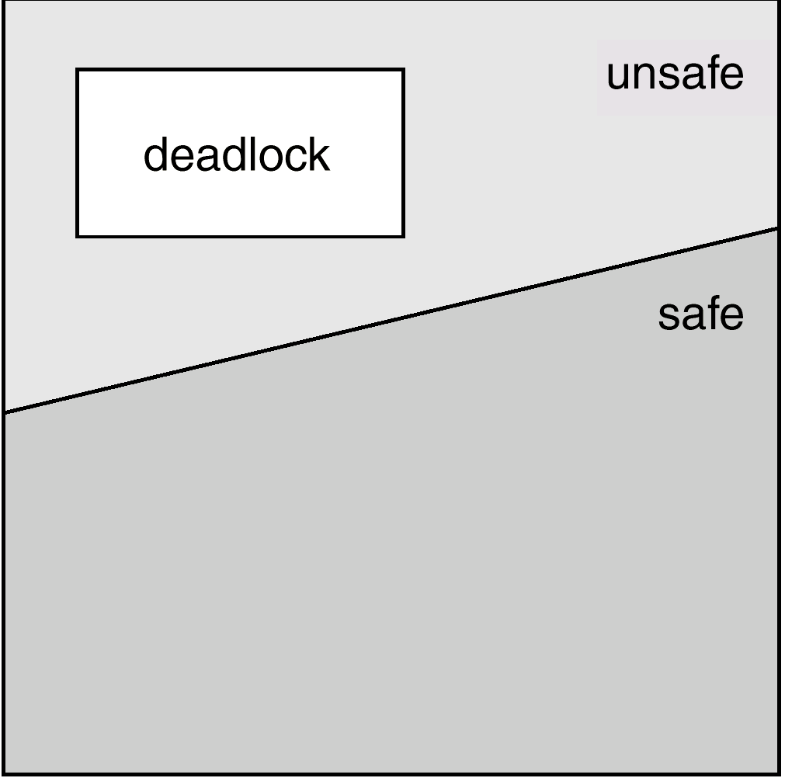

Slide 23
Safe and unsafe states
Total resources are 10
7 resources already allocated
So there are 3 still free
A need 6 resources more to complete it.
B need 2 resources more to complete it.
C need 5 resources more to complete it.
Process | Has | Max
A | 3 | 9
B | 2 | 4
C | 2 | 7
Free : 3

Slide 24
Safe states
Process | Has | Max
A | 3 | 9
B | 2 | 4
C | 2 | 7
Free : 3
Process | Has | Max
A | 3 | 9
B | 4 | 4
C | 2 | 7
Free : 1
Process | Has | Max
A | 3 | 9
B | 0 | -
C | 2 | 7
Free : 5
2
4
Process | Has | Max
A | 3 | 9
B | 0 | -
C | 7 | 7
Free : 0
Process | Has | Max
A | 3 | 9
B | 0 | -
C | 0 | -
Free : 7
Process | Has | Max
A | 9 | 9
B | 0 | -
C | 0 | -
Free : 1
5
6
7

Slide 25

Unsafe states
Process | Has | Max
A | 3 | 9
B | 2 | 4
C | 2 | 7
Free : 3
Process | Has | Max
A | 4 | 9
B | 2 | 4
C | 2 | 7
Free : 2
Process | Has | Max
A | 4 | 9
B | 4 | 4
C | 2 | 7
Free : 0
1
2
Process | Has | Max
A | 4 | 9
B | 0 | -
C | 2 | 7
Free : 4
4

Slide 26
Banker’s Algorithm
Used for multiple instances of each resource type.
Each process must a priori claim maximum use of each resource type.
When a process requests a resource it may have to wait.
When a process gets all its resources it must return them in a finite amount of time.

Slide 27
Data Structures for the Banker’s Algorithm
Let n = number of processes and m = number of resource types.
Available: Vector of length m. If Available[j] = k, there are k instances of resource type Rj available.
Max: n × m matrix. If Max[i,j] = k, then process Pi may request at most k instances of resource type Rj.
Allocation: n × m matrix. If Allocation[i,j] = k, then process Pi is currently allocated k instances of resource type Rj.
Need: n × m matrix. If Need[i,j] = k, then process Pi may need k more instances of resource type Rj to complete its task.
Need[i,j] = Max[i,j] - Allocation[i,j]

Slide 28
Safety Algorithm
Step 1:Let Work and Finish be vectors of length m and n, respectively. Initialize
Work := Available
Finish[i] := false for i = 1,2,…,n.
Step 2:Find an i (i.e. process Pi) such that both:
Finish[i] = false
Need_i <= Work
If no such i exists, go to step 4.
Step 3: Work := Work + Allocation_i
Finish[i] := true
go to step 2
Step 4: If Finish[i] = true for all i, then the system is in a safe state.

Slide 29
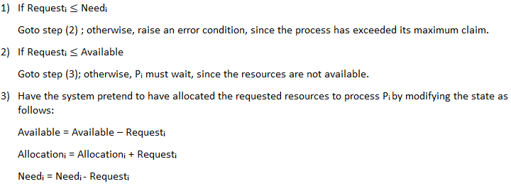
Resource-Request Algorithm

Slide 30
Banker’s algorithm for single resource
What the algorithm does is check to see if granting the request leads to an unsafe state. If it does, the request is denied.
If granting the request leads to a safe state, it is carried out.
If we have situation as per figure
then it is safe state
because with 10 free units
one by one all customers can be served.
Process | Has | Max
A | 0 | 6
B | 0 | 5
C | 0 | 4
D | 0 | 7
Free : 10

Slide 31
Banker’s algorithm for single resource
Process | Has | Max
A | 1 | 6
B | 1 | 5
C | 2 | 4
D | 4 | 7
Free : 2
Process | Has | Max
A | 1 | 6
B | 1 | 5
C | 4 | 4
D | 4 | 7
Free : 0
Process | Has | Max
A | 1 | 6
B | 1 | 5
C | 0 | 0
D | 4 | 7
Free : 4
Process | Has | Max
A | 1 | 6
B | 1 | 5
C | 0 | -
D | 7 | 7
Free : 1
Process | Has | Max
A | 1 | 6
B | 1 | 5
C | 0 | -
D | 0 | -
Free : 8
Process | Has | Max
A | 1 | 6
B | 5 | 5
C | 0 | -
D | 0 | -
Free : 4

Slide 32

Banker’s algorithm for single resource
Process | Has | Max
A | 1 | 6
B | 0 | -
C | 0 | -
D | 0 | -
Free : 9
Process | Has | Max
A | 6 | 6
B | 0 | -
C | 0 | -
D | 0 | -
Free : 4
Process | Has | Max
A | 0 | -
B | 0 | -
C | 0 | -
D | 0 | -
Free : 10
The order of execution is C, D, B, A. So if we can find proper order of execution then there is no deadlock.

Slide 33
Banker’s algorithm for single resource
Process | Has | Max
A | 1 | 6
B | 2 | 5
C | 2 | 4
D | 4 | 7
Free : 1

Slide 34
Banker’s algorithm for multiple resource
Tape Drive | Plotters | Scanners | CD Roms
6 | 3 | 4 | 2
Tape Drive | Plotters | Scanners | CD Roms
5 | 3 | 2 | 2
Tape Drive | Plotters | Scanners | CD Roms
1 | 0 | 2 | 0
total no of each resource
resources hold
Available (free) resources
Process | Tape Drive | Plotters | Scanners | CD Roms
P1 | 3 | 0 | 1 | 1
P2 | 0 | 1 | 0 | 0
P3 | 1 | 1 | 1 | 0
P4 | 1 | 1 | 0 | 1
P5 | 0 | 0 | 0 | 0
Process | Tape Drive | Plotters | Scanners | CD Roms
P1 | 1 | 1 | 0 | 0
P2 | 0 | 1 | 1 | 2
P3 | 3 | 1 | 0 | 0
P4 | 0 | 0 | 1 | 0
P5 | 2 | 1 | 1 | 0
no of resources held by each process
no of resources still needed by each process to proceed

Slide 35
Banker’s algorithm for multiple resource
Tape Drive | Plotters | Scanners | CD Roms
6 | 3 | 4 | 2
Tape Drive | Plotters | Scanners | CD Roms
5 | 3 | 2 | 2
Tape Drive | Plotters | Scanners | CD Roms
1 | 0 | 1 | 0
total no of each resource
resources hold
Available (free) resources
Process | Tape Drive | Plotters | Scanners | CD Roms
P1 | 3 | 0 | 1 | 1
P2 | 0 | 1 | 0 | 0
P3 | 1 | 1 | 1 | 0
P4 | 1 | 1 | 1 | 1
P5 | 0 | 0 | 0 | 0
Process | Tape Drive | Plotters | Scanners | CD Roms
P1 | 1 | 1 | 0 | 0
P2 | 0 | 1 | 1 | 2
P3 | 3 | 1 | 0 | 0
P4 | 0 | 0 | 0 | 0
P5 | 2 | 1 | 1 | 0
no of resources held by each process
no of resources still needed by each process to proceed

Slide 36
Banker’s algorithm for multiple resource
Tape Drive | Plotters | Scanners | CD Roms
6 | 3 | 4 | 2
Tape Drive | Plotters | Scanners | CD Roms
5 | 3 | 2 | 2
Tape Drive | Plotters | Scanners | CD Roms
2 | 1 | 2 | 1
total no of each resource
resources hold
Available (free) resources
Process | Tape Drive | Plotters | Scanners | CD Roms
P1 | 3 | 0 | 1 | 1
P2 | 0 | 1 | 0 | 0
P3 | 1 | 1 | 1 | 0
P4 | - | - | - | -
P5 | 0 | 0 | 0 | 0
Process | Tape Drive | Plotters | Scanners | CD Roms
P1 | 1 | 1 | 0 | 0
P2 | 0 | 1 | 1 | 2
P3 | 3 | 1 | 0 | 0
P4 | 0 | 0 | 0 | 0
P5 | 2 | 1 | 1 | 0
no of resources held by each process
no of resources still needed by each process to proceed

Slide 37
Banker’s algorithm for multiple resource
Tape Drive | Plotters | Scanners | CD Roms
6 | 3 | 4 | 2
Tape Drive | Plotters | Scanners | CD Roms
5 | 3 | 2 | 2
Tape Drive | Plotters | Scanners | CD Roms
1 | 0 | 2 | 1
total no of each resource
resources hold
Available (free) resources
Process | Tape Drive | Plotters | Scanners | CD Roms
P1 | 4 | 1 | 1 | 1
P2 | 0 | 1 | 0 | 0
P3 | 1 | 1 | 1 | 0
P4 | - | - | - | -
P5 | 0 | 0 | 0 | 0
Process | Tape Drive | Plotters | Scanners | CD Roms
P1 | 0 | 0 | 0 | 0
P2 | 0 | 1 | 1 | 2
P3 | 3 | 1 | 0 | 0
P4 | 0 | 0 | 0 | 0
P5 | 2 | 1 | 1 | 0
no of resources held by each process
no of resources still needed by each process to proceed

Slide 38
Banker’s algorithm for multiple resource
Tape Drive | Plotters | Scanners | CD Roms
6 | 3 | 4 | 2
Tape Drive | Plotters | Scanners | CD Roms
5 | 3 | 2 | 2
Tape Drive | Plotters | Scanners | CD Roms
5 | 1 | 3 | 2
total no of each resource
resources hold
Available (free) resources
Process | Tape Drive | Plotters | Scanners | CD Roms
P1 | - | - | - | -
P2 | 0 | 1 | 0 | 0
P3 | 1 | 1 | 1 | 0
P4 | - | - | - | -
P5 | 0 | 0 | 0 | 0
Process | Tape Drive | Plotters | Scanners | CD Roms
P1 | 0 | 0 | 0 | 0
P2 | 0 | 1 | 1 | 2
P3 | 3 | 1 | 0 | 0
P4 | 0 | 0 | 0 | 0
P5 | 2 | 1 | 1 | 0
no of resources held by each process
no of resources still needed by each process to proceed

Slide 39
Banker’s algorithm for multiple resource
Tape Drive | Plotters | Scanners | CD Roms
6 | 3 | 4 | 2
Tape Drive | Plotters | Scanners | CD Roms
5 | 3 | 2 | 2
Tape Drive | Plotters | Scanners | CD Roms
5 | 0 | 2 | 0
total no of each resource
resources hold
Available (free) resources
Process | Tape Drive | Plotters | Scanners | CD Roms
P1 | - | - | - | -
P2 | 0 | 2 | 1 | 2
P3 | 1 | 1 | 1 | 0
P4 | - | - | - | -
P5 | 0 | 0 | 0 | 0
Process | Tape Drive | Plotters | Scanners | CD Roms
P1 | 0 | 0 | 0 | 0
P2 | 0 | 0 | 0 | 0
P3 | 3 | 1 | 0 | 0
P4 | 0 | 0 | 0 | 0
P5 | 2 | 1 | 1 | 0
no of resources held by each process
no of resources still needed by each process to proceed

Slide 40
Banker’s algorithm for multiple resource
Tape Drive | Plotters | Scanners | CD Roms
6 | 3 | 4 | 2
Tape Drive | Plotters | Scanners | CD Roms
5 | 3 | 2 | 2
Tape Drive | Plotters | Scanners | CD Roms
5 | 2 | 3 | 2
total no of each resource
resources hold
Available (free) resources
Process | Tape Drive | Plotters | Scanners | CD Roms
P1 | - | - | - | -
P2 | - | - | - | -
P3 | 1 | 1 | 1 | 0
P4 | - | - | - | -
P5 | 0 | 0 | 0 | 0
Process | Tape Drive | Plotters | Scanners | CD Roms
P1 | 0 | 0 | 0 | 0
P2 | 0 | 0 | 0 | 0
P3 | 3 | 1 | 0 | 0
P4 | 0 | 0 | 0 | 0
P5 | 2 | 1 | 1 | 0
no of resources held by each process
no of resources still needed by each process to proceed

Slide 41
Banker’s algorithm for multiple resource
Tape Drive | Plotters | Scanners | CD Roms
6 | 3 | 4 | 2
Tape Drive | Plotters | Scanners | CD Roms
5 | 3 | 2 | 2
Tape Drive | Plotters | Scanners | CD Roms
2 | 1 | 3 | 2
total no of each resource
resources hold
Available (free) resources
Process | Tape Drive | Plotters | Scanners | CD Roms
P1 | - | - | - | -
P2 | - | - | - | -
P3 | 4 | 2 | 1 | 0
P4 | - | - | - | -
P5 | 0 | 0 | 0 | 0
Process | Tape Drive | Plotters | Scanners | CD Roms
P1 | 0 | 0 | 0 | 0
P2 | 0 | 0 | 0 | 0
P3 | 0 | 0 | 0 | 0
P4 | 0 | 0 | 0 | 0
P5 | 2 | 1 | 1 | 0
no of resources held by each process
no of resources still needed by each process to proceed

Slide 42
Banker’s algorithm for multiple resource
Tape Drive | Plotters | Scanners | CD Roms
6 | 3 | 4 | 2
Tape Drive | Plotters | Scanners | CD Roms
5 | 3 | 2 | 2
Tape Drive | Plotters | Scanners | CD Roms
6 | 3 | 4 | 2
total no of each resource
resources hold
Available (free) resources
Process | Tape Drive | Plotters | Scanners | CD Roms
P1 | - | - | - | -
P2 | - | - | - | -
P3 | - | - | - | -
P4 | - | - | - | -
P5 | 0 | 0 | 0 | 0
Process | Tape Drive | Plotters | Scanners | CD Roms
P1 | 0 | 0 | 0 | 0
P2 | 0 | 0 | 0 | 0
P3 | 0 | 0 | 0 | 0
P4 | 0 | 0 | 0 | 0
P5 | 2 | 1 | 1 | 0
no of resources held by each process
no of resources still needed by each process to proceed

Slide 43
Banker’s algorithm for multiple resource
Tape Drive | Plotters | Scanners | CD Roms
6 | 3 | 4 | 2
Tape Drive | Plotters | Scanners | CD Roms
5 | 3 | 2 | 2
Tape Drive | Plotters | Scanners | CD Roms
4 | 2 | 3 | 2
total no of each resource
resources hold
Available (free) resources
Process | Tape Drive | Plotters | Scanners | CD Roms
P1 | - | - | - | -
P2 | - | - | - | -
P3 | - | - | - | -
P4 | - | - | - | -
P5 | 2 | 1 | 1 | 0
Process | Tape Drive | Plotters | Scanners | CD Roms
P1 | 0 | 0 | 0 | 0
P2 | 0 | 0 | 0 | 0
P3 | 0 | 0 | 0 | 0
P4 | 0 | 0 | 0 | 0
P5 | 0 | 0 | 0 | 0
no of resources held by each process
no of resources still needed by each process to proceed

Slide 44
Banker’s algorithm for multiple resource
Tape Drive | Plotters | Scanners | CD Roms
6 | 3 | 4 | 2
Tape Drive | Plotters | Scanners | CD Roms
5 | 3 | 2 | 2
Tape Drive | Plotters | Scanners | CD Roms
6 | 3 | 4 | 2
total no of each resource
resources hold
Available (free) resources
Process | Tape Drive | Plotters | Scanners | CD Roms
P1 | - | - | - | -
P2 | - | - | - | -
P3 | - | - | - | -
P4 | - | - | - | -
P5 | - | - | - | -
Process | Tape Drive | Plotters | Scanners | CD Roms
P1 | 0 | 0 | 0 | 0
P2 | 0 | 0 | 0 | 0
P3 | 0 | 0 | 0 | 0
P4 | 0 | 0 | 0 | 0
P5 | 0 | 0 | 0 | 0
no of resources held by each process
no of resources still needed by each process to proceed

Slide 45
Banker’s algorithm for multiple resource
Tape Drive | Plotters | Scanners | CD Roms
6 | 3 | 4 | 2
Tape Drive | Plotters | Scanners | CD Roms
5 | 3 | 2 | 2
Tape Drive | Plotters | Scanners | CD Roms
1 | 0 | 2 | 0
total no of each resource
resources hold
Available (free) resources
Process | Tape Drive | Plotters | Scanners | CD Roms
P1 | 3 | 0 | 1 | 1
P2 | 0 | 1 | 0 | 0
P3 | 1 | 1 | 1 | 0
P4 | 1 | 1 | 0 | 1
P5 | 0 | 0 | 0 | 0
Process | Tape Drive | Plotters | Scanners | CD Roms
P1 | 1 | 1 | 0 | 0
P2 | 0 | 1 | 1 | 2
P3 | 3 | 1 | 0 | 0
P4 | 0 | 0 | 1 | 1
P5 | 2 | 1 | 1 | 0
no of resources held by each process
no of resources still needed by each process to proceed

Slide 46
Deadlock Detection
If deadlocks are not avoided, then another approach is to detect when they have occurred and recover somehow.
In addition to the performance hit of constantly checking for deadlocks, a policy / algorithm must be in place for recovering from deadlocks.

Slide 47
Deadlock detection for single resource
We are starting from node D.
Empty list L = ()
Add current node so Empty list = (D).
From this node there is one outgoing arc to T so add T to list.
So list become L = (D, T).
Continue this step….so we get list as below
L = (D, T, E)………… L = (D, T, E, V, G, U, D)
In the above step in empty list the node D appears twice, so deadlock.
R
A
B
C
S
D
T
E
F
U
V
W
G

Slide 48
Deadlock detection for single resource
Algorithm for detecting deadlock for single resource
For each node, N in the graph, perform the following five steps with N as the starting node.
Initialize L to the empty list, designate all arcs as unmarked.
Add current node to end of L, check to see if node now appears in L two times. If it does, graph contains a cycle (listed in L), algorithm terminates.
From given node, see if any unmarked outgoing arcs. If so, go to step 4; if not, go to step 5.
Pick an unmarked outgoing arc at random and mark it. Then follow it to the new current node and go to step 2.
If this is initial node, graph does not contain any cycles, algorithm terminates. Otherwise, dead end. Remove it, go back to previous node, make that one current node, go to step 2.
An algorithm to detect a cycle in a graph requires an order of n^2 operations, where n is the number of vertices in the graph.

Slide 49
Several instances of a resource type
Data Structures
Available: Vector of length m. If Available[j] = k, there are k instances of resource type Rj available.
Allocation: n × m matrix. If Allocation[i,j] = k, then process Pi is currently allocated k instances of resource type Rj.
Request: An n × m matrix indicates the current request of each process. If Request [i,j] = k, then process Pi is requesting k more instances of resource type Rj .

Slide 50
Deadlock Detection Algorithm
Step 1: Let Work and Finish be vectors of length m and n, respectively. Initialize
Work := Available
For i = 1,2,…,n, if Allocation(i) ≠ 0, then Finish[i] := false, otherwise Finish[i] := true.
Step 2: Find an index i such that both:
Finish[i] = false
Request (i) ≤ Work
If no such i exists, go to step 4.

Slide 51
Deadlock Detection Algorithm
Step 3: Work := Work + Allocation(i)
Finish[i] := true
go to step 2
Step 4: If Finish[i] = false for some i, 1 ≤ i ≤ n, then the system is in a deadlock state. Moreover, if Finish[i] = false, then Pi is deadlocked.
Algorithm requires an order of m × (n^2) operations to detect whether the system is in a deadlocked state.

Slide 52
Deadlock detection for multiple resource
E =
Tape Drive | Plotters | Scanners | CD Roms
4 | 2 | 3 | 1
Tape Drive | Plotters | Scanners | CD Roms
2 | 1 | 0 | 0
A =
total no of each resource
no of resources that are available (free)
Process | Tape Drive | Plotters | Scanners | CD Roms
P1 | 0 | 0 | 1 | 0
P2 | 2 | 0 | 0 | 1
P3 | 0 | 1 | 2 | 0
Process | Tape Drive | Plotters | Scanners | CD Roms
P1 | 2 | 0 | 0 | 1
P2 | 1 | 0 | 1 | 1
P3 | 2 | 1 | 0 | 0
C =
R =
no of resources held by each process
no of resources still needed by each process to proceed

Slide 53
Deadlock detection for multiple resource
Tape Drive | Plotters | Scanners | CD Roms
4 | 2 | 3 | 1
Tape Drive | Plotters | Scanners | CD Roms
0 | 0 | 0 | 0
E =
A =
total no of each resource
no of resources that are available (free)
Process | Tape Drive | Plotters | Scanners | CD Roms
P1 | 0 | 0 | 1 | 0
P2 | 2 | 0 | 0 | 1
P3 | 2 | 2 | 2 | 0
Process | Tape Drive | Plotters | Scanners | CD Roms
P1 | 2 | 0 | 0 | 1
P2 | 1 | 0 | 1 | 1
P3 | 0 | 0 | 0 | 0
C =
R =
no of resources held by each process
no of resources still needed by each process to proceed

Slide 54
Deadlock detection for multiple resource
Tape Drive | Plotters | Scanners | CD Roms
4 | 2 | 3 | 1
Tape Drive | Plotters | Scanners | CD Roms
2 | 2 | 2 | 0
E =
A =
total no of each resource
no of resources that are available (free)
Process | Tape Drive | Plotters | Scanners | CD Roms
P1 | 0 | 0 | 1 | 0
P2 | 2 | 0 | 0 | 1
P3 | 0 | 0 | 0 | 0
Process | Tape Drive | Plotters | Scanners | CD Roms
P1 | 2 | 0 | 0 | 1
P2 | 1 | 0 | 1 | 1
P3 | 0 | 0 | 0 | 0
C =
R =
DEADLOCK
no of resources held by each process
no of resources still needed by each process to proceed

Slide 55
Detection-Algorithm Use
When, and how often to invoke depends on:
How often a deadlock is likely to occur?
How many processes will need to be rolled back?
One for each disjoint cycle
How often --
Every time a request for allocation cannot be granted immediately
Allows us to detect set of deadlocked processes and process that “caused” deadlock. Extra overhead.
Every hour or whenever CPU utilization drops.
With arbitrary invocation there may be many cycles in the resource graph and we would not be able to tell which of the many deadlocked processes “caused” the deadlock.

Slide 56
Deadlock recovery
Recovery through pre-emption
In this method resources are temporarily taken away from its current owner and give it to another process.
The ability to take a resource away from a process, have another process use it, and then give it back without the process noticing it is highly dependent on the nature of the resource.
Recovering this way is frequently difficult or impossible.
Hold
P1
Request
Hold
R1
R2
P2
Hold

Slide 57
Deadlock recovery (cont…)
Recovery through rollback
PCB (Process Control Block) and resource state are periodically saved at “checkpoint”.
When deadlock is detected, rollback the preempted process up to the previous safe state before it acquired that resource.
Discard the resource manipulation that occurred after that checkpoint.
Start the process after it is determined it can run again.
A
A
A
A
F1
R
F2
R
B
First
Checkpoints
Second
Checkpoints

Slide 58
Deadlock recovery (cont…)
Recovery through killing processes
The simplest way to break a deadlock is to kill one or more processes.
Kill all the process involved in deadlock
Kill process one by one.
After killing each process check for deadlock
If deadlock recovered then stop killing more process
Otherwise kill another process

Slide 59

ABHIJITSINH PARMAR

